Slide 1
Applications of Deep Learning in GIS – Spatiotemporal data mining and forecasting
Thesis Presentation
Student: Supasin Wuthikulphakdi, TKU#608785068
Advisor: Yihjia Tsai Ph.D.

Slide 2
Contribution
In ECE), I compared as many models as I could.
DEEPFORECAST multi-LSTM is the best
1.575 RMSE, 1.159 MAE
Among competing models, more complex ones aren’t always better.
Proven by metrics to be shown
PEMS-BAY trained STDL models better than METR-LA.
In my CEHE,
I chose familiar models of each domain (S/T) to train with my fire event dataset
VAE is the best in the space domain
0.026348 RMSE, 0.009244 MAE
FBProphet is the best in the time domain
6.97231 RMSE, 5.045342 MAE
LSTM doesn’t always beat FBProphet

Slide 3
Motivation
Intelligent transport system (ITS)
Disaster & Weather forecast
To study DL-Implementations in STDM
To mine ST-data is laborious
Deep learning can help -> self-feature extraction
Do newer STDM-DL models outperform older ones?

Slide 4
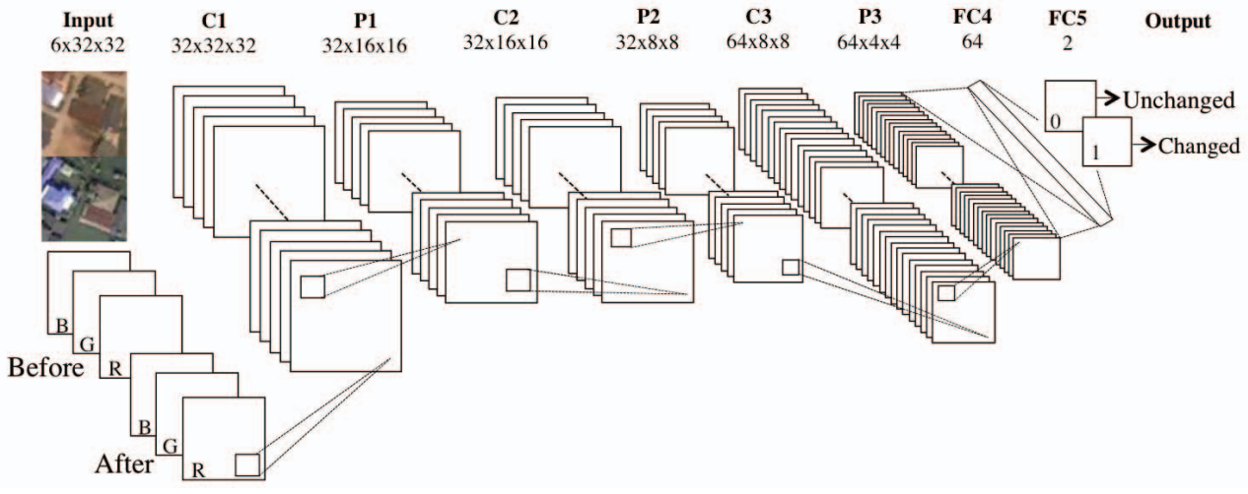
Uses of STDM
Meteorology
Transportation (Most popular)
ITS
On-Demand Services
Taxi-hailing apps
LBSN
Criminology
Etc.

Slide 5
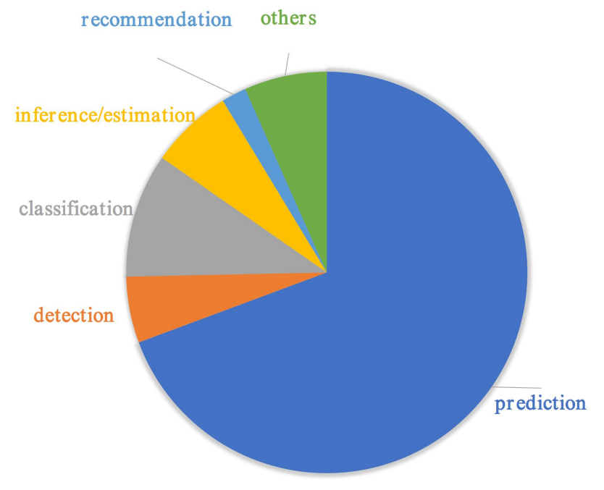
Literature Review - Early WORKS
Disaster Impact Analysis & Detection
Doshi et al.’s CNN [1,2]
Amit & Aoki FC-CNN [3]
Fang’s LSS-LSTM [6]
GEO-Feature Detection
Iglovikov et al.’s UNET [4]
Earlier surveys
Wang et al. [8]
Atluri et al. [19]

Slide 6
Literature Review – Implemented models
2.2 (ECE)
2.3 (CEHE)
DCRNN [7]
STGCN [9]
ST-METANET[16]
CRANN [15]
Adaptive GCNN [71]
Attention-based ST-GCN [72]
Deepforecast Multi-LSTM[73]
Spacetimeformer [80]
Autoencoders
BAE
VAE
CVAE
GAN
DCGAN
WGAN
LSGAN
FBProphet
ARIMA
LSTM
MMS = Matrix Manipulation System

Slide 7
Hypothesis
Q1: STDM DL-models can do a variety of learning and predictions, but how well can they do?
Metrics: MSE, RMSE, & MAE
Q2: If I have a custom dataset with its data structure visualised, which model to be learned from it?
Such as the “NTPC-fire_2015-17” dataset
Which is small.
What if I vary some hyperparameters?

Slide 8
Experiment Episode 1: Exploratory Comparative Experiment (ECE)
Architecture | Architecture Description | Dataset Name/Desc | learning rate | Epochs | Major DL Module
Taxi-Simple-LSTM-Pytorch | Simple-LSTM | Time series of Taxi-Uber DS. (2014-15) | 0.01 | 2000 | Pytorch
Uber-Simple-LSTM-Pytorch | Simple-LSTM | Time series of Taxi-Uber DS. (2014-15) | 0.01 | 2000 | Pytorch
Taxi-Simple-LSTM-Keras | Simple-LSTM | Time series of Taxi-Uber DS. (2014-16) | 0.001 | 100 | TensorFlow Keras
Uber-Simple-LSTM-Keras | Simple-LSTM | Time series of Taxi-Uber DS. (2014-17) | 0.001 | 100 | TensorFlow Keras
CRANN-Temporal | Bahdanau Att.Mech Autoencoder (LSTM based) | temporal time series of hourly/daily car traffic (in Madrid) | 0.01 | 200 | Pytorch
CRANN-Spatial | CNN+ST-Att.Mech | graph data captured by 30 sensors + Timestamps (A 17000x30 matrix) | 0.01 | 200 | Pytorch
CRANN-Dense | Fully Connected Feedforward NN (FCFFNN) | dense 3D+ tensor of both preceding modules | 0.01 | 200 | Pytorch
Seq2seq (flow) | Improved Seq2eq | Beijing TDrive | 0.01 | 200 | MXNET
GAT Seq2seq (flow) | Improved Seq2eq | Beijing TDrive | 0.01 | 200 | MXNET
ST-Metanet (flow) | Improved Seq2eq | Beijing TDrive | 0.01 | 200 | MXNET
Seq2seq (speed) | Improved Seq2eq | METR-LA | 0.01 | 200 | MXNET
GAT Seq2seq (speed) | Improved Seq2eq | METR-LA | 0.01 | 200 | MXNET
ST-Metanet (speed) | Improved Seq2eq | METR-LA | 0.01 | 200 | MXNET
AGCRN | Attentive Graph CRN | Caltrans PEMS04&08 | 0.003 | 100 | Pytorch
ASTGCN | Attention Based GCN | Caltrans PEMS04&08 | 0.001 | 80 | Pytorch
Deepforecast | Multi-LSTM | MS_winds - Wind Speed & Flow Dataset | 0.001 | 80 | TensorFlow Keras
DCRNN | R-CNN | PEMS & METR-LA | 0.001 | 100 | TensorFlow Keras
STGCN | Graph-CNN | PEMS & METR-LA | 0.001 | 50 | Pytorch
Spacetimeformer | Transformer opted for ST-data | METR-LA | 0.001 | 80 | Pytorch
Hyperparameters: default
Optimiser: Adam
Environment: COLAB GPU, TWCC
Method: run models, record and compare their metrics.

Slide 9
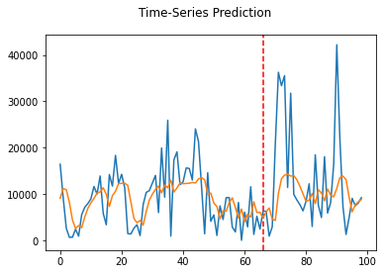
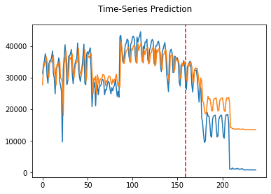
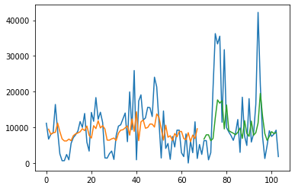
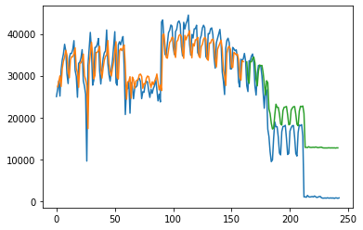
ECE results:
 |  | Key Metrics |  | Other Metrics |  |  |  | Key Metrics |  | Other Metrics
Architecture | MSE | RMSE | MAE | Type | Value | Architecture | MSE | RMSE | MAE | Type | Value
Taxi-Simple-LSTM-pytorch | 72269860 | 8501.168 | 5753.569 |  |  | AGCRN - PeMSD4 | 1040.761367 | 32.26083333 | 19.69416667 | MAPE (TWCC) | 13.02040833
Uber-Simple-LSTM-pytorch | 0.0332864 | 0.1824457 | 0.13018544 |  |  | AGCRN - PeMSD8 | 718.9101563 | 26.8125 | 17.01583333 | MAPE(COLAB) | 10.65138333
Taxi-Simple-LSTM-Keras | 93431556 | 9666 | 92.484945 |  |  | ASTGCN - PeMSD4 | 1173.7476 | 34.26 | 21.84 | MAPE | 0.15
Uber-Simple-LSTM-Keras | 105050200.4 | 10249.4 | 83.21 |  |  | ASTGCN - PeMSD8 | 809.4025 | 28.45 | 18.5 | MAPE | 0.11
CRANN-Temporal | 6653.6636 | 81.569992 | 50.3727684 | Bias | -3.82883501 | Deepforecast | 2.481881285 | 1.5753988 | 1.1590073 | NRMSE_maxmin(%) | 15.575216
 |  |  |  | Relative error % | 24.85518008 |  |  |  |  | NRMSE_mean(%) | 43.097104
CRANN-Spatial | 55740.719 | 236.09472 | 117.7406616 | Bias | -14.2317371 | DCRNN(Metr-LA)-STA - 15min | 75.5161 | 8.69 | 4.02 | MAPE | 9.39
 |  |  |  | Relative error % | 9.053748846 | DCRNN(Metr-LA)-STA - 1hr | 201.9241 | 14.21 | 6.79 | MAPE | 16.71
CRANN-Dense | 67264.055 | 259.35315 | 138.2879333 | Bias | -4.71734381 | DCRNN(Metr-LA)-VAR- 15min | 60.5284 | 7.78 | 4.37 | MAPE | 10.08
 |  |  |  | Relative error % | 24.85518008 | DCRNN(Metr-LA)-VAR - 1hr | 114.0624 | 10.68 | 6.5 | MAPE | 15.84
Seq2seq (flow) [14] | 1626.986623 | 40.33592224 | 21.3 |  |  | DCRNN(Pemsbay)-STA - 15min | 11.7649 | 3.43 | 1.6 | MAPE | 3.24
GAT Seq2seq (flow) [14] | 1098.041371 | 33.13670731 | 18.3 |  |  | DCRNN(Pemsbay)-STA - 1hrmin | 49.2804 | 7.02 | 3.05 | MAPE | 6.84
ST-Metanet (flow) [14] | 813.1885148 | 28.51646042 | 16.9 |  |  | DCRNN(Pemsbay)-VAR - 15min | 9.5481 | 3.09 | 1.74 | MAPE | 3.59
Seq2seq (speed) [14] | 44.4751941 | 6.668972492 | 3.55 |  |  | DCRNN(Pemsbay)-VAR - 1hr | 26.1121 | 5.11 | 2.92 | MAPE | 6.46
GAT Seq2seq (speed) [14] | 36.92343427 | 6.076465607 | 3.28 |  |  | STGCN - 15min | 16.532356 | 4.066 | 2.231 | %Wmape | 5.206
ST-Metanet (speed) [14] | 33.63158961 | 5.799274921 | 3.05 |  |  | STGCN - 30 min | 33.051001 | 5.749 | 3.04 | %Wmape | 7.386
 |  |  |  |  |  | STGCN - 45min | 46.744569 | 6.837 | 3.623 | %Wmape | 8.927
 |  |  |  |  |  | Spacetimeformer [80] | 36.21 | 6.017474553 | 2.82 | MAPE | 7.71
 |  |  |  |  |  |  |  |  |  | model.loss | 0.258
Deepforecast Multi-LSTM
Is the best model to date
1.575 RMSE, 1.159 MAE
All model performed well
At least for their arch.
LSTM on the TAXI-Uber data
Had a poor metrics
Simplicity, overfitting, gradient vanishing & explosion
PYTORCH
TF-Keras
Uber
Uber
Taxi
Taxi

Slide 10
CEHE – Procedure
Download & visualise the dataset
Extract spatial (coordinates) and temporal features.
Spat.F. = coordinates, temp.F. = timestamps with one frequency each
Convert coordinates to rasterised heatmaps
And temporal features to time series
Run spatial models on rasterised heatmaps
And temporal models on time series
Visualise and record the results

Slide 11
EP2: Custom Event Heatmap Experiment (CEHE) Hyperparameters (HPs): - Epochs: 100 - Optimiser: Adam, LR = 0.001 - OTHERWISE, default according to their origins.
MODEL | DOMAIN | Batch size | Train Metrics: |  |  |  | Test Metrics:
 |  |  | MSE | RMSE | MAE | MAPE | MSE | RMSE | MAE | MAPE
PreMMS LSTM4 |  |  | 91.630625 | 9.572389 | 5.251044 | 0.244517 | 50.876132 | 7.132751 | 5.399653 | 0.369033
PostMMS-LSTM4-noLB | Time | 1LB | 7.679134 | 2.771125 | 1.556069 | 0.133908 | 61.438013 | 7.83824 | 5.954068 | 0.29369
PostMMS-LSTM-LB5 | Time | 5LB | 7.582465 | 2.753628 | 1.559106 | 0.138684 | 57.692435 | 7.595554 | 5.70559 | 0.283949
BAE | Space | 24tr + 12te | 0.00280751 | 0.05298596 | 0.04602381 | 38999060 | 0.00357825 | 0.05981846 | 0.053716972 | 46504212
DCGAN | Space | 9 | 0.02931224 | 0.17120818 | 0.04847476 | 1127299.4 | 0.02781864 | 0.16678922 | 0.0468716 | 598425
FBProphet (37 days) | Time | 1 day | n/a | n/a | n/a | n/a | 48.613108 | 6.97231 | 5.045342 | 0.281977
CVAE | Space | 9 | 0.00515399 | 0.07179128 | 0.01000213 | 4424340 | 0.00433511 | 0.06584153 | 0.009183249 | 4546362.5
VAE | Space | 9 | 0.00083985 | 0.02898009 | 0.009215273 | 2282401.2 | 0.00069422 | 0.02634812 | 0.00924397 | 1.30263E+13
WGAN-GP | Space | 9 | 0.00812537 | 0.09014085 | 0.021708265 | 8.3067E+11 | 0.00754667 | 0.08687156 | 0.02071965 | 7.40703E+11
Weekly ARIMA | Time | 7 days | n/a | n/a | n/a | n/a | 1436.90057 | 37.9064714 | 28.42712296 | 0.195063926
LSGAN | Space | 9 | 0.1126827 | 0.33568244 | 0.18267849 | 0.57419306 | 0.10933066 | 0.33065187 | 0.18496665 | 0.5471558
PostMMS-LSTM-Weekly | Time | 7 days | 227.370864 | 15.078822 | 10.250484 | 0.086445 | 852.383545 | 29.195608 | 21.007481 | 0.143819
PostLSTM9 | Time | 5LB | 7.578619 | 2.752929 | 1.563434 | 0.139068 | 55.893509 | 5.60772 | 5.70559 | 0.281344
In the spatial domain
VAE is the Best
Due to moderate simplicity & well tuned HPs despite minimal touches
Due to my small data size (36samples, 36*784 rpsns)
GANs did not beat the AEs
In the temporal domain (1096 samples)
FBProphet is the best
Never overfits but can be overtaken by PreMMS LSTM if well tuned.
Hidden subtest:
Add lookback steps (+)
Add more LSTM cells (+)

Slide 12
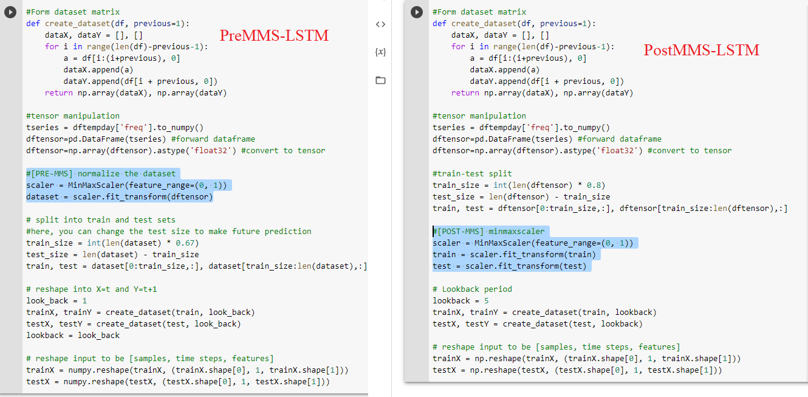

Slide 13
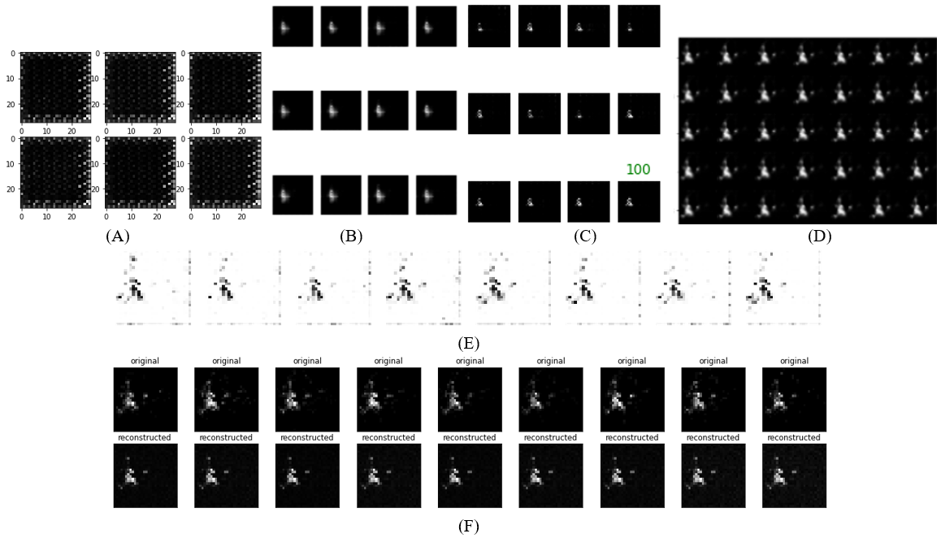
Spatial domain analysis :The Batch Size test
 |  | TFK-DCGAN | TFK-CVAE | TFK-VAE | TFK-WGAN-GP | TFK-LSGAN | TFK-BAE
Train 9B: | MSE | 0.02931224 | 0.00515399 | 0.00083985 | 0.00812537 | 0.1126827 | 0.00280751
 | RMSE | 0.17120818 | 0.07179128 | 0.02898009 | 0.09014085 | 0.335682439 | 0.05298596
 | MAE | 0.04847476 | 0.01000213 | 0.00921527 | 0.02170827 | 0.18267849 | 0.04602381
Test 9B: | MSE | 0.02781864 | 0.00433511 | 0.00069422 | 0.00754667 | 0.10933066 | 0.00357825
 | RMSE | 0.16678922 | 0.06584153 | 0.02634812 | 0.08687156 | 0.330651874 | 0.05981846
 | MAE | 0.0468716 | 0.00918325 | 0.00924397 | 0.02071965 | 0.18496665 | 0.05371697
Train 12B: | MSE | 0.02113337 | 0.00419831 | 0.00082212 | 0.02267304 | 0.40772453
 | RMSE | 0.14537322 | 0.06479436 | 0.02867267 | 0.15057571 | 0.638533108
 | MAE | 0.0444729 | 0.00805869 | 0.00947048 | 0.04603831 | 0.24995048
Test 12B: | MSE | 0.01843591 | 0.003209 | 0.00079672 | 0.02239976 | 0.41008073
 | RMSE | 0.13577889 | 0.05664803 | 0.02822621 | 0.14966548 | 0.640375461
 | MAE | 0.04102352 | 0.00706938 | 0.00987247 | 0.04573417 | 0.24851514
Expand the training batch (9 -> 12)
DCGAN & CVAE improved
WGAN-GP & LSGAN worsened
VAE
Somewhat improved train MSE
While slightly worsened others
Is the best spatial model
LSGAN
VAE
CVAE
DCGAN
WGAN-GP
BAE

Slide 14
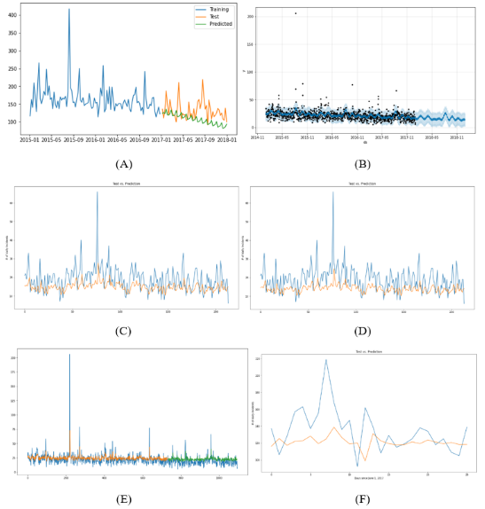
Visualised Frequency Prediction
A = Weekly Auto ARIMA
B = FBProphet
C = MMS-LSTM-5LB
D = MMS-LSTM-noLB
E = Vanilla LSTM
F = LSTM-Weekly

Slide 15
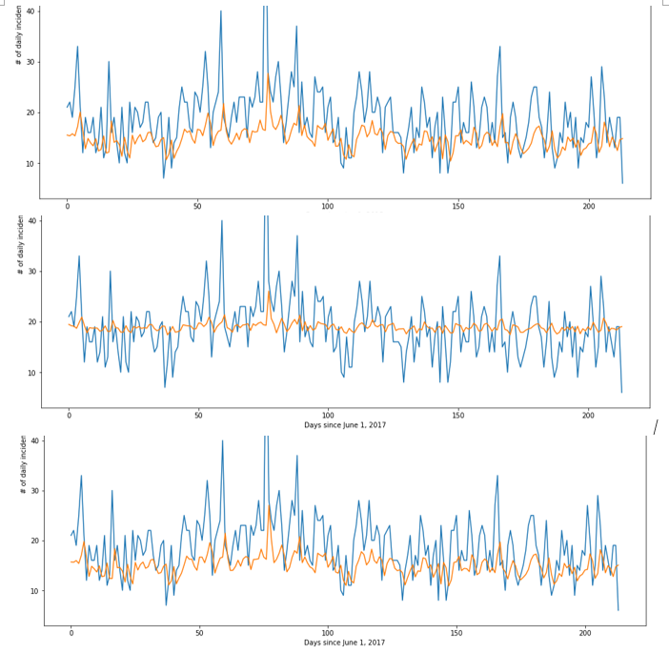
What if I use the weekly model to test the daily data
Top = LSTM4
Middle = LSTM4 trained with weekly series
Bottom = LSTM9

Slide 16
Findings of my Thesis & Discussion (1/2)
The ECE taught me that
ST-METANET, Pems-DRCNN, STGCN & Spacetimeformer performed similarly well.
PEMS bay train each model better than METR-LA
Each model did well for its architecture.
The Spat. CEHE taught me that
AEs are better that GANs for smaller datasets
GANs are harder to train & require more data than AEs
Due to the much larger representation size (S:28224(36*28*28) vs T:1096) and milder gradient
Spatial models are much better than temporal ones, as they experienced much larger data
Future plans & recommendations
More LSTM/AE/GAN variants
Daily rasterisation alg.
Do more subtests
Vary more HPs
broader HP-ranges
The Temp. CEHE taught me that
As long as FBProphet is better, never trust the LSTM.
It’s possible that vanilla LSTM will defeat FBProphet (if well tuned)
The more frequent a series, the better a model trains.
The ST-METANET & Spacetimeformer
Have a RAM problem
Finally, I’ve learned that
Newer, more complex models doesn’t always outperform older, more simple ones
The subtests will eventually lead to
“HP-Tuning”

Slide 17
Findings of my Thesis & Discussion (2/2)
Open questions
Is there any model that are good and dealing with CEHE dataset BOTH in spacial and temporal domain?
Currently no, because the datasets of most of the explored models involve sensors recording values at each timestamp
But my dataset has no sensors, only list of coordinates with only 1 frequency each. And thus, must be rasterized to predict/reconstruct heatmaps.
If you combine the best in temporal model and the best in spatial model for CEHE dataset, what would be the model looked like?
VAE-FBP, VAE-LSTM

Slide 18
References
[1] Doshi, J., Basu, S. and Pang, G., 2018. From satellite imagery to disaster insights. arXiv preprint arXiv:1812.07033.
[2] Doshi, Jigar. 2018. Residual Inception Skip Network for Binary Segmentation. Pages 216–219 of: Proceedings of the IEEE Conference on Computer Vision and Pattern Recognition Workshops. [3] Amit, S.N.K.B. and Aoki, Y., 2017, September. Disaster detection from aerial imagery with convolutional neural network. In 2017 International Electronics Symposium on Knowledge Creation and Intelligent Computing (IES-KCIC) (pp. 239-245). IEEE.
[4] V. Iglovikov, S. Mushinskiy, and V. Osin, “Satellite Imagery Feature Detection using Deep Convolutional Neural Network: A Kaggle Competition,” vol. June 2017.
[6] Fang, Z., Wang, Y., Peng, L. and Hong, H., 2020. Predicting flood susceptibility using LSTM neural networks. Journal of Hydrology, [online] p.125734. Available at: <https://doi.org/10.1016/j.jhydrol.2020.125734> [Accessed 18 April 2021].
[7] Li, Y., Yu, R., Shahabi, C., & Liu, Y. (2017). Diffusion convolutional recurrent neural network: Data-driven traffic forecasting. arXiv preprint arXiv:1707.01926.
[8] S. Wang, J. Cao, & P. Yu, "Deep Learning for Spatio-Temporal Data Mining: A Survey," in IEEE Transactions on Knowledge and Data Engineering, doi: 10.1109/TKDE.2020.3025580.
[9] Yu, B., Yin, H., & Zhu, Z. (2017). Spatiotemporal graph convolutional networks: A deep learning framework for traffic forecasting. arXiv preprint arXiv:1709.04875.
[15] de Medrano, R., & Aznarte, J. L. (2020). A spatiotemporal attention-based spot-forecasting framework for urban traffic prediction. Applied Soft Computing, 96, 106615.
[16] Luo, X., Li, D., & Zhang, S. (2019). Traffic flow prediction during the holidays based on DFT and SVR. Journal of Sensors, 2019.
[19] Atluri, G., Karpatne, A., & Kumar, V. (2018). Spatiotemporal data mining: A survey of problems and methods. ACM Computing Surveys (CSUR), 51(4), 1-41.
[71] Bai, L., Yao, L., Li, C., Wang, X., & Wang, C. (2020). Adaptive graph convolutional recurrent network for traffic forecasting. arXiv preprint arXiv:2007.02842.
[72] Guo, S., Lin, Y., Feng, N., Song, C., & Wan, H. (2019, July). Attention based spatial-temporal graph convolutional networks for traffic flow forecasting. In Proceedings of the AAAI Conference on Artificial Intelligence (Vol. 33, No. 01, pp. 922-929).
[73] Ghaderi, A., Sanandaji, B. M., & Ghaderi, F. (2017). Deep forecast: Deep learning-based spatiotemporal forecasting. arXiv preprint arXiv:1707.08110.
[80] Grigsby, J., Wang, Z., & Qi, Y. (2021). Long-Range Transformers for Dynamic Spatiotemporal Forecasting. arXiv preprint arXiv:2109.12218.

Slide 19
Discussion & Conclusion: What have I done?
Technical basics
Applications, DL-Techniques
Paper survey
SOTA models are compared in my ECE.
Common models are implemented to my fire event data
Comparison tests
ECE
CEHE
How STDM works?
Rasterised Heatmap Generation
Time series prediction
HP subtests
Discovered facts
(Newer, more complex vs older, more simple models)
[BEST ECE] DEEPFORECAST multi-LSTM
[BEST CEHE] VAE & FBProphet
Discussion
Gave future subtest recomms.
Listed some open problems
Further discuss the results
Pointed out current issues
Indicated future research directions.

Slide 20

Question Time!
Q&As.

